Slide 1
CryptoForensics: Trocking Illicit Tronsoctions
Exploring blockchain solutions to enhance transparency and accountability in tracking illicit cryptocurrency transactions for law enforcement and financial sectors.
Prepared by: Team BlockMinds

Slide 2

Crypto Forensics
CryptoForensics: Trocking Illicit Tronsoctions
A groundbreaking blockchain solution designed to enhance transparency and accountability in cryptocurrency transactions, ensuring a safer digital economy.
^œn'ea 1°nç preseutotions

Slide 3
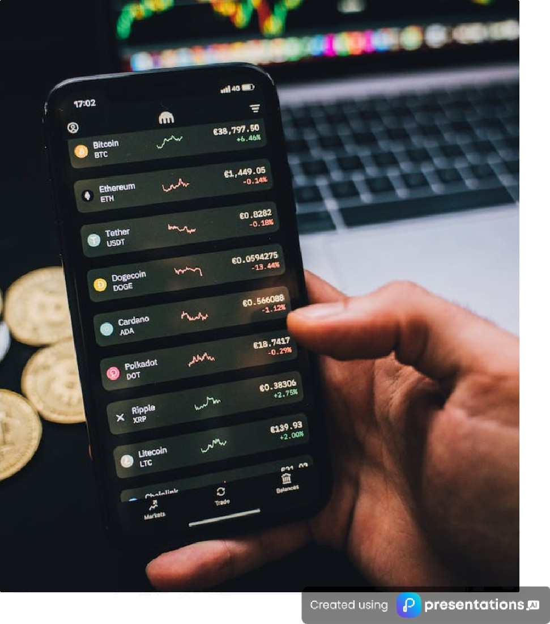
Challenges in Trocking Crypto Transactions
An Overview of Key Issues
Pseudonymity of Cryptocurrencies
Cryptocurrencies like Bitcoin provide anonymity, complicating the tracing of transactions.
Obfuscotion Techniques
Methods such as tumblers and mixers obscure transaction trails, making tracking difficult.
Low Enforcement Needs
Agencies require advanced tools to trace end receivers of cryptocurrencies linked to crime.
Growing Illicit Use
The rise of cryptocurrencies in illegal trade on darknet marketplaces demands urgent monitoring solutions.

Slide 4
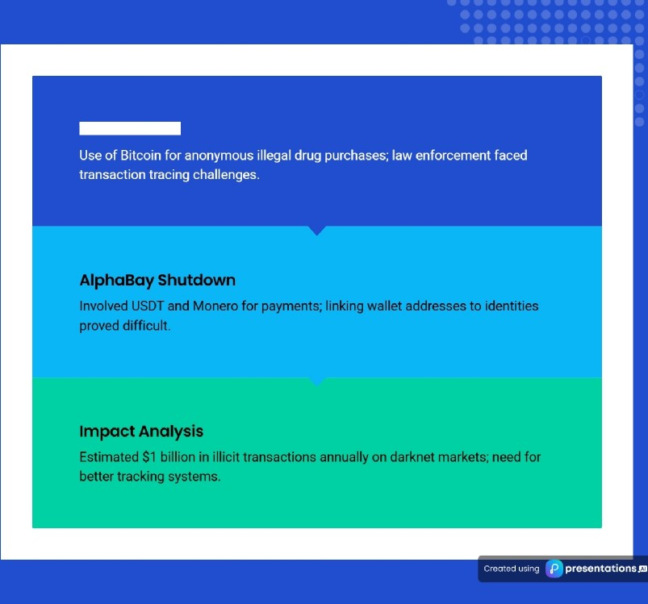
Crypto in Drug
The Silk Rood
Trafficking Case Studies
Exploring the role of cryptocurrency in illicit drug trade

Slide 5
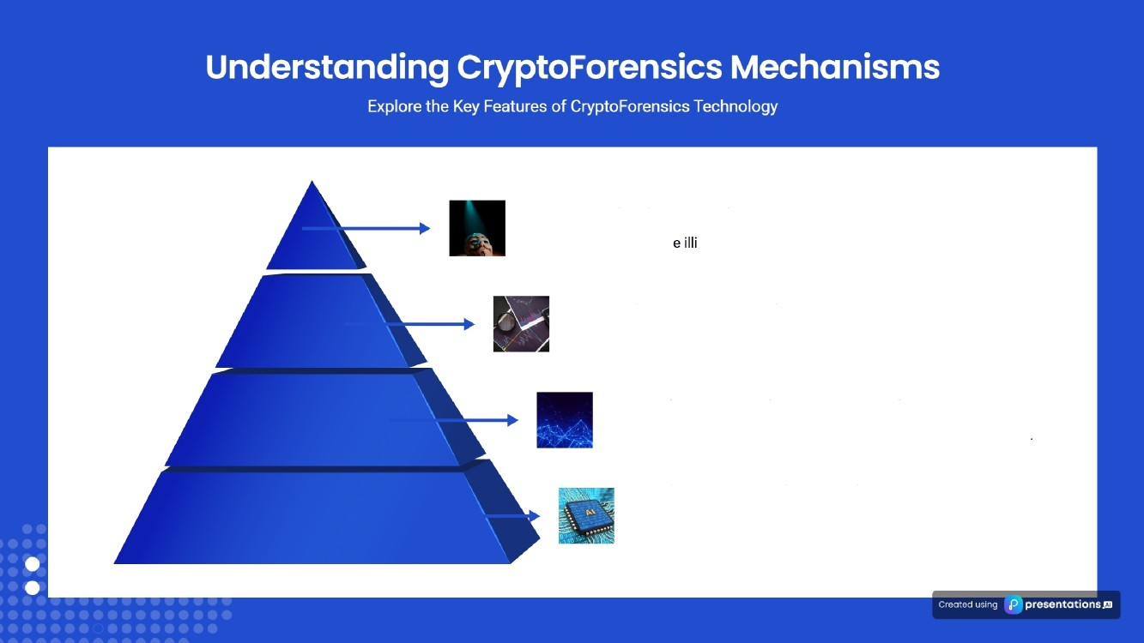
De-ononymizotion Techniques
Employs methods to trac cit funds by breaking anonymity barriers.
Transaction Graph Analysis
Visualizes transaction flows to detect suspicious activities and networks.
On-chain & Off-chain Data Correlation
Integrates blockchain data with external sources for holistic insights
Al-Driven Blockchoin Analytics
Utilizes AI to analyze blockchain data, revealing hidden transaction patterns.

Slide 6
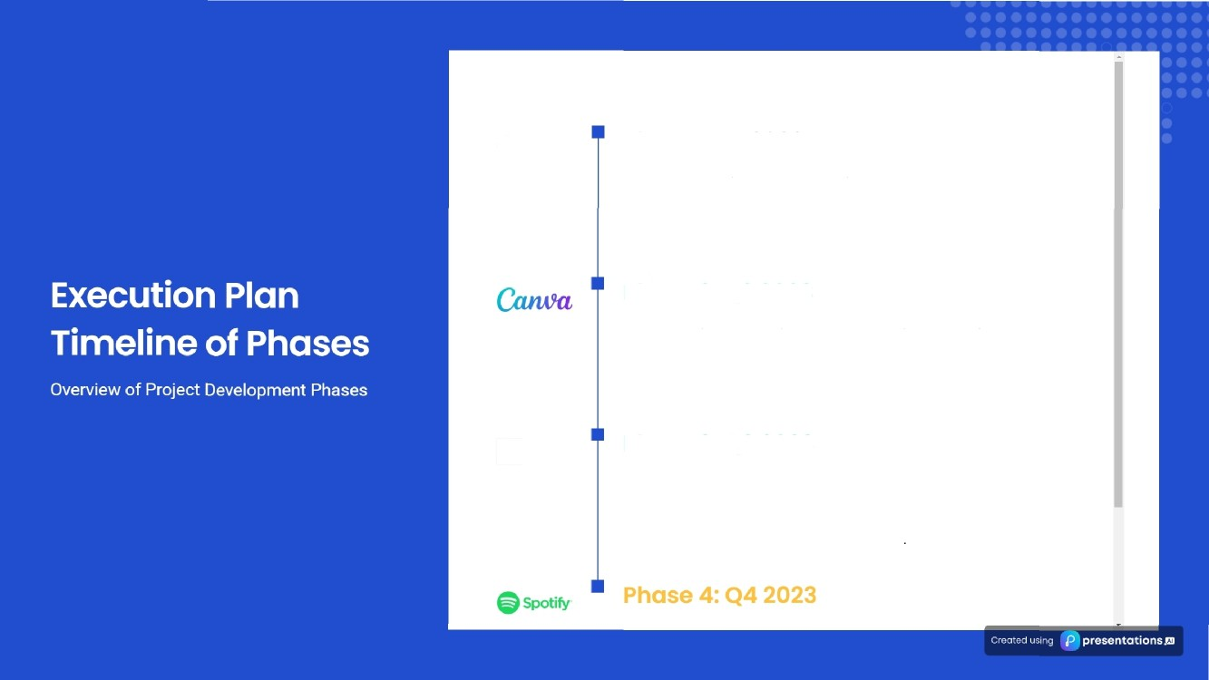
Google
Phase 1: QT 2023
Data Collection & Processing
Aggregated blockchain transaction data and monitored darknet intelligence for insights.
Phase 2: Q2 2023
Transaction Trocking A Anonymity Breaking
Conducted graph-based analysis of fund movements and trained AI models for money laundering techniques.
vision
Phase 3: Q3 2023
Low Enforcement Dashboard Development Created an interactive forensic dashboard and developed a comprehensive case management system

Slide 7


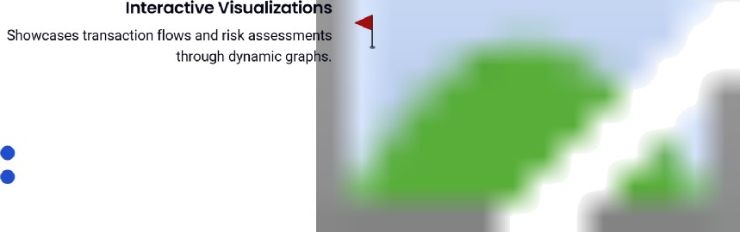
Dashboard UI & Anolytics Tools
Explore the key functionalities of our dashboard
Automated Alerts
Provides real-time notifications for any suspicious activities detected.
Case Management Features
Enables tracking of individual wallet transactions over time for better oversight.
^œn'ea 1°nç preseutotions

Slide 8
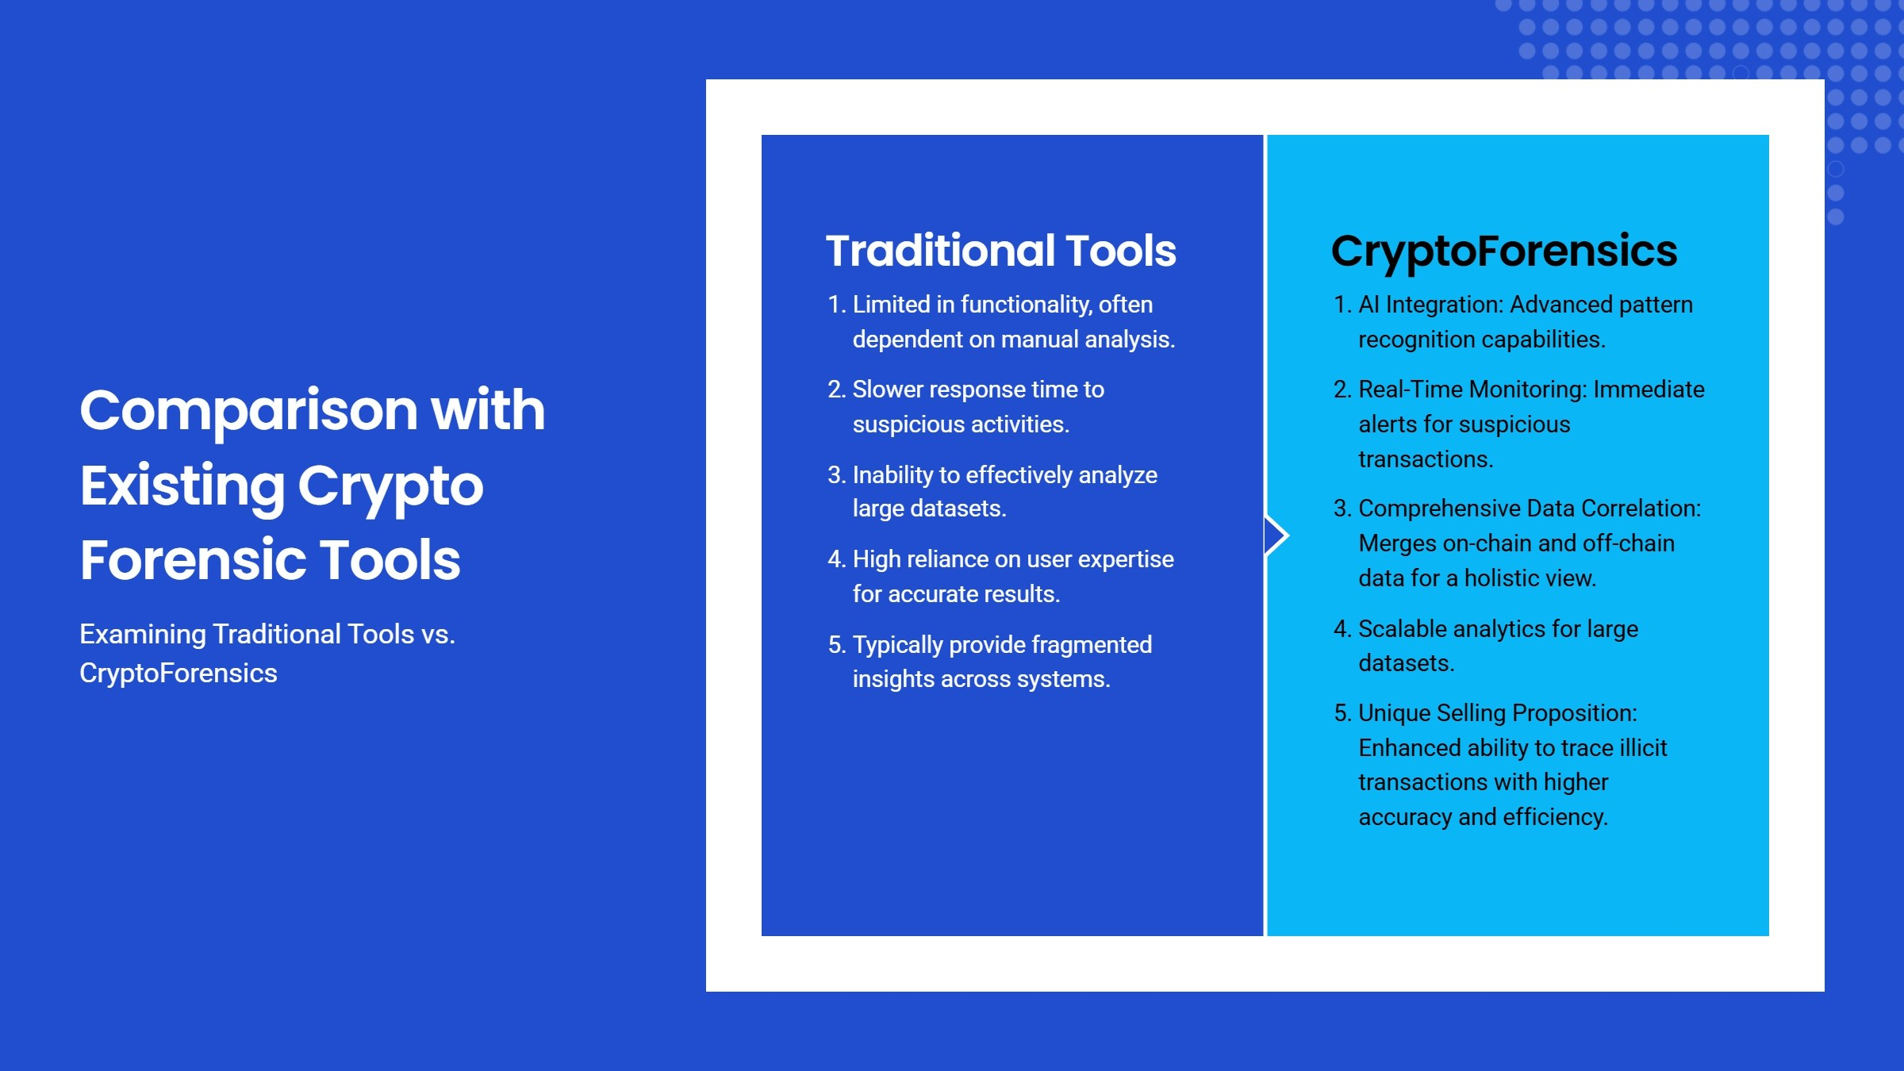


Slide 9

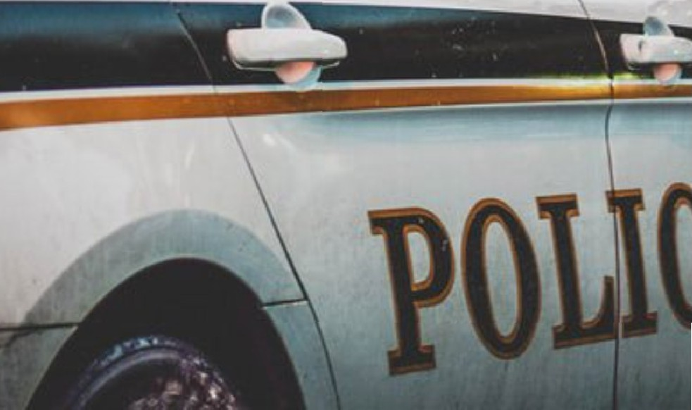
Strategic Roadmap for Future Growth
Key Strategies for Expansion and Collaboration
Scalability Plans
Expansion to encompass more blockchain networks and cryptocurrencies enhances our reach.
Partnership Opportunities
Fostering collaborations with law enforcement and regulatory bodies for improved data sharing.
Adoption Goals
Striving to be the preferred forensic tool for global law enforcement agencies.
Continuous Improvement
Ongoing enhancements driven by user feedback and advancements in technology.
’œn'eó'1°nç preseutotions

